Slide 1
Module 14
Describing Printed Music
RDA Training
Utah State Library
Harold B. Lee Library, Brigham Young University
April 2014
Notes:
This module is intended to cover special procedures for printed music that differ from books. We’ve already covered thoroughly how to describe a book. We won’t go over all that again, exept to note when you do the same thing for printed music.

Slide 2
Please log in to RDA
http://access.rdatoolkit.org/login
Notes:
From now on, as I show slides of RDA, please feel free to go ahead and look yourself in the Toolkit.

Slide 3
Mode of Issuance
Single unit monograph?
Multipart monograph?
Serial?
Integrating resource?
Notes:
This module only covers monographs.

Slide 4
Basis for Identification
RDA 2.1
Single unit monograph
  The item itself
Multipart monograph
  The first unit
Notes:
The Brahms sonata is an example.

Slide 5
Preferred Source of Information
RDA 2.2.2
Choose, in the part chosen as the basis for identification,
  the title sheet, title page, or title card
  if none of these is available, use (in this order)
  cover
  caption
  masthead
  colophon

Slide 6
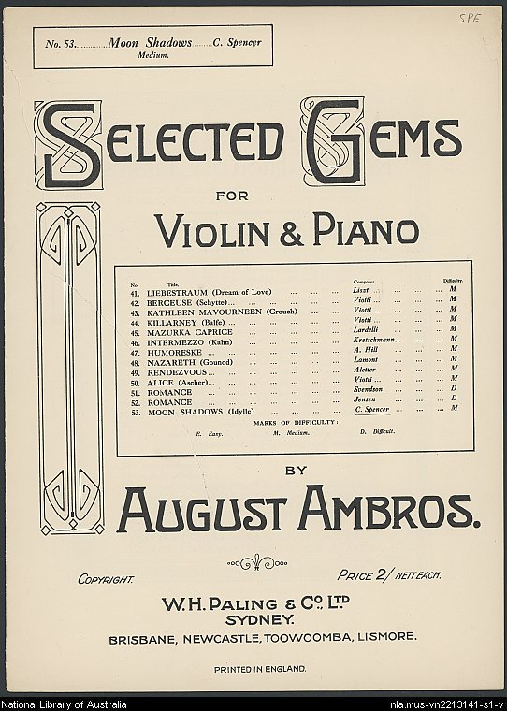
Preferred Source of Information
RDA 2.2.2
“List title page”
Notes:
A typical kind of title page you might have to deal with with music. If this is the only source in the resource that bears a title, use it as the preferred source of information, but only record information about the resource itself, not all the other things in the list.

Slide 7
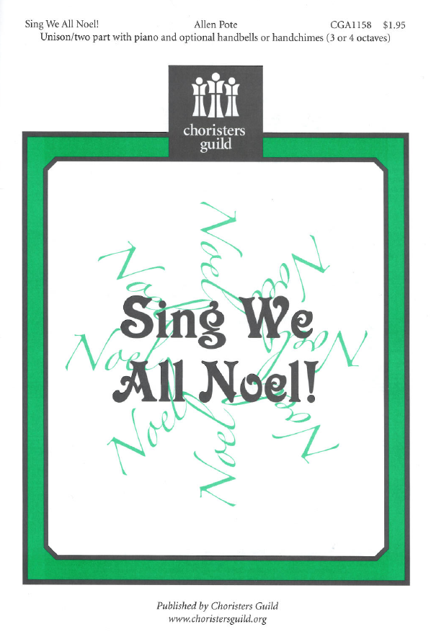
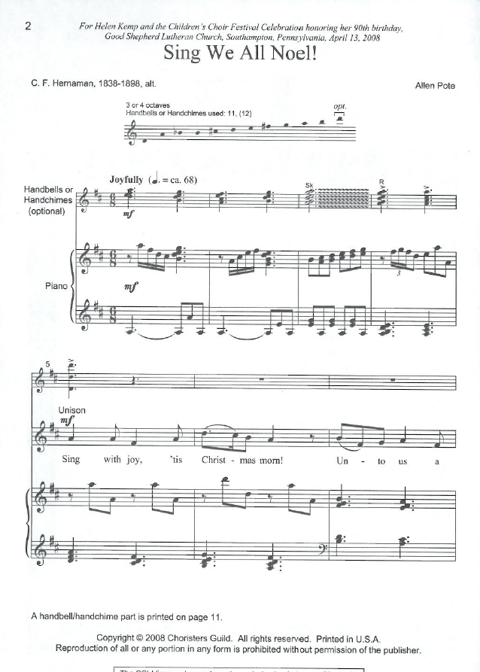
Preferred source?
Notes:
No title page. We have a cover and a caption. Which one?

Slide 8
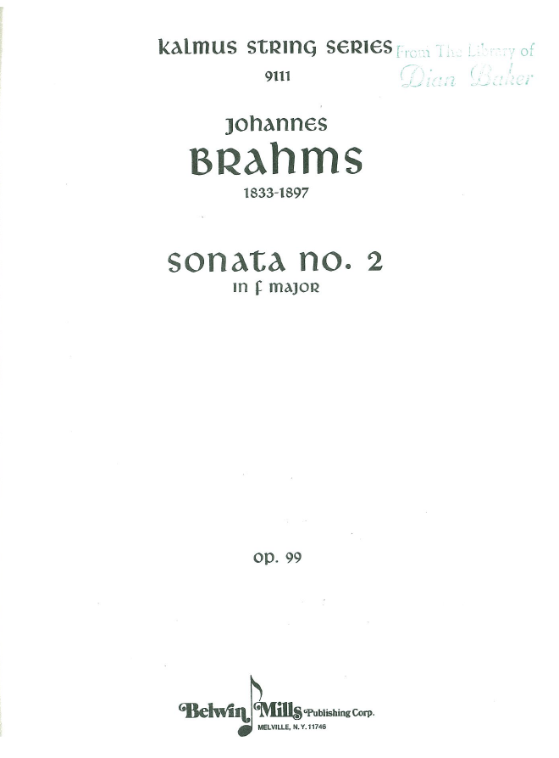
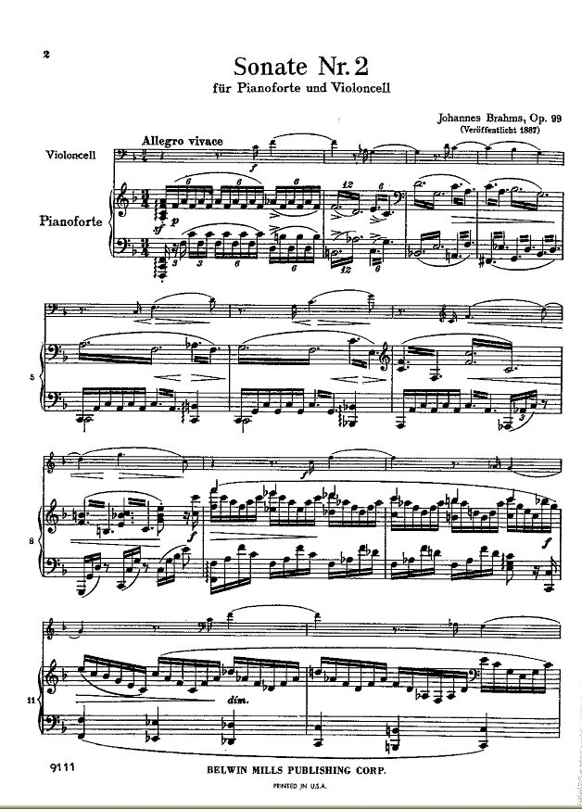
Preferred source?
Notes:
No title page. We have a title page and a caption. Which one?

Slide 9
Title
Transcribe the title proper, parallel title proper and other title information exactly as found on the preferred source.
  245 10 $a Sing we all Noel! : $b unison/two part with piano and optional handbells or handchimes (3 or 4 octaves)
  245 10 $a Sonata no. 2 in F major, op. 99
Notes:
Read RDA 2.3.2.8.1 on the other title information for Sing we all Noel!

Slide 10
Variant title
Variant titles are not core. Record any variant titles you think would help a library user find the resource in a 246 field
    245 10 $a Sonata no. 2 in F major, op. 99
    246 13 $a Sonate Nr. 2 für Pianoforte und Violoncell
Notes:
Read RDA 2.3.2.8.1 on the variant title for the Brahms

Slide 11
Statement of Responsibility
Same as for other formats
  The first statement of responsibility relating to the title proper is core, i.e., required. Others are optional.
  Statements of responsibility relating to the title proper may be taken from any source in the resource, i.e., they do not have to appear with the title proper
Record in 245 subfield $c following space-slash-space

Slide 12
Statement of Responsibility
245 10 $a Sing we all Noel! : $b unison/two part with piano and optional handbells or handchimes (3 or 4 octaves) / $c [music by] Allen Pote ; [words by] C.F. Hernaman.
245 10 $a Sonata no. 2 in F major, op. 99 / $c Johannes Brahms.
Notes:
Two points about Sing we all Noel!
(1) Read together 2.4.2.2 sources of information. Statements of responsibility can come from anywhere in the resource without bracketing. “Allen Pote” came from the preferred source, but “C.F. Hernaman” came from the first page of the music.
(2) Read together 2.4.1.7 clarification of role. If the role of the entity named in the statement of responsibility is not clear, add a word or phrase clarifying it. Here if we just copied the statements of responsibility we would leave a misleading impression that they were both the composer. Note: in captions on music the position of the names is important. The person named to the left wrote the words; the person named to the right wrote the music.

Slide 13
Edition Statement
Transcribe any edition statement you find.
    245 10 $a Violad : $b for two violas / $c Luna Pearl Woolf.
    250 $a Full score.
    245 10 $a Piano concerto in F major / $c Wolfgang Amadeus Mozart.
    250 $a Edition for 2 pianos.
Notes:
A couple of examples of music edition statements. This sort of thing used to be recorded in MARC 254. Now obsolete.

Slide 14
Publication Statement
Record publication information as you find it (or supply)
  245 10 $a Sing we all Noel! : $b unison/two part with piano and optional handbells or handchimes (3 or 4 octaves) / $c [music by] Allen Pote ; [words by] C.F. Hernaman.
  264 _1 $a [Dallas, Texas] : $b Choristers Guild, $c [2008]
  245 10 $a Sonata no. 2 in F major, op. 99 / $c Johannes Brahms.
  264 _1 $a Melville, N.Y. : $b Belwin Mills Publishing Corp., $c [between 1970 and 1979?]
Notes:
Publication information is often very spotty in printed music.
In the case of Sing we Noel! I went to the publisher’s website and learned that their office is in Dallas, Texas. I inferred the publication date from the copyright date. This was a pretty safe bet in this case, but often printed music is a republication which simply photographically reprints an earlier edition. If you have a piece of music that looks very new and has no date other than a copyright date 1945, the date of publication is probably not 1945, especially if it’s not just a reprint by the same publisher as the original.
Music publishers are notorious for this. The Brahms piece has no date on it at all. I learned from poking around in Google that Belwin-Mills is no longer in Melville, N.Y. but no idea when they moved. Looking at the music (and the fact that it has a $3.00 price sticker on the cover) it looks like it might be from the 1970s. This isn’t very satisfactory but it was the best I could do. Note the fact that the publisher’s name is recorded exactly as it appears.

Slide 15
Copyright information
Copyright is not core, but often recorded for printed music, particularly in the absence of an explicit publication date
      245 10 $a Sing we all Noel! : $b unison/two part with piano and optional handbells or handchimes (3 or 4 octaves) / $c [music by] Allen Pote ; [words by] C.F. Hernaman.
      264 _1 $a [Dallas, Texas] : $b Choristers Guild, $c [2008]
      264 _4 $c ©2008

Slide 16
Distribution information
Optionally record distribution information
  264 _2 $b Universal Music & Video Distribution
    Source reads: Distributed by Universal Music & Video Distribution; no place given
Notes:
You don’t need to record a place, in fact you don’t need to record any of it--none of it is core unless publication information has not been identified.

Slide 17
Manufacture information
Optionally record manufacture information
  264 _2 $b Hal Leonard Corp.
  264 _3 $b Hal Leonard Corp.
    Source reads: Printed and distributed by Hal Leonard Corp.
Notes:
Note in this case Hal Leonard Corp. is both the printer and the distributor.

Slide 18
Extent (3.4.3)
Record the number of units with a term from the notated music format list in 7.20.1.3
In parentheses, specify the number of pages, etc.
    300 $a 1 score (3 volumes)
    300 $a 1 vocal score (25 pages)
    300 $a 5 parts
Notes:
Go to 3.4.3, then 7.20.1.3

Slide 19
Extent (3.4.3)
If the resource consists of a score and one or more parts in a single unit:
          245 10 $a Sing we all Noel! : $b unison/two part with piano and optional handbells or handchimes (3 or 4 octaves) / $c [music by] Allen Pote ; [words by] C.F. Hernaman.
          300 $a 1 vocal score and 1 part (11 pages)
Notes:
Go to 3.4.3, then 7.20.1.3

Slide 20
Extent (3.4.3)
If the resource consists of a score and one or more parts in more than one unit:
    245 10 $a Sonata no. 2 in F major, op. 99 / $c Johannes Brahms.
    300 $a 1 score (30 pages) + 1 part (9 pages)
Notes:
Go to 3.4.3, then 7.20.1.3

Slide 21
Illustrative and Color Content
(RDA 7.15, 7.17)
Rare with printed music, but record if present
Record in subfield $b of 300, following a colon
  300 $a 1 score (25 pages) : $b color illustrations ; $c 30 cm
Notes:
Read 7.15 and 7.17. together

Slide 22
Dimensions (3.5)
Record dimensions according to the appropriate format in 3.5.1.4. The most common for printed music are volume and sheet
  Volume: record height of volume (3.5.1.4.14)
    300 ... ; $c 30 cm
  Sheet: record height x width (3.5.1.4.11)
    300 ... ; $c 29 x 20 cm
Notes:
Everyone open to 3.5.1.4. The preferred unit of measure is metric

Slide 23
Dimensions (3.5)
    245 10 $a Sonata no. 2 in F major, op. 99 / $c Johannes Brahms.
    300 $a 1 score (30 pages) + 1 part (9 pages) ; $c 31 cm
    245 10 $a Sing we all Noel! : $b unison/two part with piano and optional handbells or handchimes (3 or 4 octaves) / $c [music by] Allen Pote ; [words by] C.F. Hernaman.
    300 $a 1 score and 1 part (11 pages) ; $c 26 cm
Notes:
Everyone open to 3.5.1.4. The preferred unit of measure is metric

Slide 24
Record content, media, and carrier type (3.2, 3.3, 6.9)
336 $a notated music $2 rdacontent
337 $a unmediated $2 rdamedia
338 $a volume $2 rdacarrier
336 $a notated music $2 rdacontent
337 $a unmediated $2 rdamedia
338 $a sheet $2 rdacarrier
Notes:
Some possible combinations for printed music.

Slide 25
Series Statement
Record series statement if present on the item (no different from any other format)
    245 10 $a Sonata no. 2 in F major, op. 99 / $c Johannes Brahms.
    490 1 $a Kalmus string series
Notes:
Note: there is a number just below the series statement, 9111, but that’s a publisher’s number or plate number, not the series numbering. The same number appears at the bottom of every page; also the series authority record says to treat this number as a publisher’s number.

Slide 26
Medium of Performance (6.15)
The instrument, instruments, voice, voices, etc., for which a musical work was originally conceived.
Follow instructions in 6.15 and best practices documents of Music Library Association
Recorded in 382 field
  382 $a mezzo-soprano $n 1 $a piano $n 1 $s 2 $2 lcmpt
  382 $a flute $n 1 $a oboe $n 1 $a bassoon $n 1 $a trombone $n 2 $a violin $n 3 $a contrabass $n 2 $s 10 $2 lcmpt

Slide 27
Medium of Performance
245 10 $a Sing we all Noel! : $b unison/two part with piano and optional handbells or handchimes (3 or 4 octaves) / $c [music by] Allen Pote ; [words by] C.F. Hernaman.
382 0_ $a chorus $v unison $e 1 $a piano $n 1 $2 lcmpt
382 0_ $a chorus $v two-part $e 1 $a piano $n 1 $2 lcmpt
382 0_ $a chorus $v unison $e 1 $a piano $n 1 $a handbell choir $p handchimes $2 lcmpt
382 0_ $a chorus $v two-part $e 1 $a piano $n 1 $a handbell choir $p handchimes $2 lcmpt
Notes:
This is a complex example.

Slide 28
Medium of Performance
    Can also be recorded as a note (see 7.21)
    245 10 $a Sonata no. 2 in F major, op. 99 / $c Johannes Brahms.
    382 0_ $a cello $n 1 $a piano $1 $s 2 $2 lcmpt
    500 $a For cello and piano.

Slide 29
Notes
Record notes as appropriate.
  form of musical notation (RDA 7.13, MARC 546 $b)
    546 $b Staff notation.
  language (RDA 7.12, MARC 546)
    546 $a German words, printed with score as well as separately with English translation.
  duration (RDA 7.22, MARC 500)
    500 $a Duration: approximately 15 minutes.
  form of composition
    500 $a Symphonic dances.
  medium of performance
    500 $a For counter-tenor, bassoon, and trombone.
Notes:
A few examples of typical notes for music. No notes are core in RDA, but form of musical notation is core for LC and PCC.

Slide 30
Notes
    245 10 $a Sing we all Noel! : $b unison/two part with piano and optional handbells or handchimes (3 or 4 octaves) / $c [music by] Allen Pote ; [words by] C.F. Hernaman.
    500 $a Title from cover.
    500 $a Handbells/handchimes part on page 11
    245 10 $a Sonata no. 2 in F major, op. 99 / $c Johannes Brahms.
    500 $a For cello and piano.
    590 $a Library copy has owner’s stamp on title page: “From the library of Dian Baker.”
Notes:
A few examples of typical notes for music.

Slide 31
Identifier for the manifestation (2.15)
Record identifiers
  ISBN in 020
  International Standard Music Number in 024 2
  Publisher number in 028 32 (RDA 2.15.2)
  Plate number in 028 22 (RDA 2.15.3)
      028 32 $a CGA1158 $b Choristers Guild
      245 10 $a Sing we all Noel! : $b unison/two part with piano and optional handbells or handchimes (3 or 4 octaves) / $c [music by] Allen Pote ; [words by] C.F. Hernaman.
      028 22 $a 09111 $b Belwin Mills
      245 10 $a Sonata no. 2 in F major, op. 99 / $c Johannes Brahms.
Notes:
A plate number is a number that appears at the bottom of each page of a music score.

Slide 32
Record Relationships
Record the principal creator. For a musical work this will usually be the composer.
    100 1 $a Brahms, Johannes, $d 1833-1897, $e composer.
    245 10 $a Sonata no. 2 in F major, op. 99 / $c Johannes Brahms.
    100 1 $a Pote, Allen, $e composer.
    245 10 $a Sing we all Noel! : $b unison/two part with piano and optional handbells or handchimes (3 or 4 octaves) / $c [music by] Allen Pote ; [words by] C.F. Hernaman.

Slide 33
Record Relationships
Record the relationship of the resource to the work embodied in it.
    100 1 $a Pote, Allen, $e composer.
    240 10 $a Sing we all Noel!
    245 10 $a Sing we all Noel! : $b unison/two part with piano and optional handbells or handchimes (3 or 4 octaves) / $c [music by] Allen Pote ; [words by] C.F. Hernaman.
    100 1 $a Brahms, Johannes, $d 1833-1897, $e composer.
    240 10 $a Sonatas, $m cello, piano, $n no. 2, op. 99, $r F major
    245 10 $a Sonata no. 2 in F major, op. 99 / $c Johannes Brahms.
Notes:
Reminder: this is done by embedding the authorized access point for the work in the record.
We’ve talked about the LC policy of not explicitly including an authorized access point for the work if the title proper in the 245 is exactly the same as the preferred title of the work. This policy is not widely followed in music cataloging (see Pote example)
Think back to the works module on creating the preferred title for a musical work.

Slide 34
Record Relationships
Record other relationships you consider important.
  245 14 $a Sonata no. 2 in F major, op. 99 / $c Johannes Brahms.
  700 1 $a Baker, Dian, $e former owner. $5UPB
  830 _0 $a Kalmus string series.
  245 10 $a Sing we all Noel! : $b unison/two part with piano and optional handbells or handchimes (3 or 4 octaves) / $c [music by] Allen Pote ; [words by] C.F. Hernaman.
  700 1_ $a Hernaman, C. F. $q (Claudia Frances), $d 1838-1898, $e lyricist.
Notes:
I checked the authority file for all these forms.

Slide 35
Relationship designators
Some common relationship designators for printed music
  composer
    100 1_ $a Bach, Johann Sebastian, $d 1685-1750, $e composer.
  librettist
    700 1_ $a Adami, Giuseppe, $d 1878-1946, $e librettist.
  lyricist
    700 1_ $a Hammerstein, Oscar, $d 1895-1960, $e lyricist.
  arranger of music
    700 1_ $a Liszt, Franz, $d 1811-1886, $e arranger of music.
  editor
    700 1_ $a Jappe, Michael, $e editor.

Slide 36
Exercise
Work together to catalog printed music workshop participants have brought, if any.

Slide 37
Module 14
Describing Printed Music
Questions?
RDA Training
Harold B. Lee Library, Brigham Young University
Fall 2015

Slide 38
This Presentation is available at
http://net.lib.byu.edu/~catalog/people/rlm/RDAUtah201511/index.htm
For further information
contact Robert L. Maxwell
robert_maxwell@byu.edu

